Slide 1


PANIMALAR ENGINEERING COLLEGE DEPARTMENT OF COMPUTER SCIENCE AND ENGINEERING CS8811 PROJECT WORK REVIEW NO: 2
FFMPEG BASED PYTOOL FOR EASY VIDEO TRANSCODING AND PROCESSING
GUIDE : MRS V.ANITHA MOSES ,ME.,(CSE)
TEAM: S.SIVAKUMAR,P.SRIRAM,SYED JAMRUDDIN
BATCH NO: C20

Slide 2
Introduction
This all-in-one tool will be helpful for performing various video conversion and processing operations. It can be used for
video and audio transcoding
video upscaling and downscaling
changing the video quality and bitrates
Muxing / Demuxing AV
ABR Stream generation and streaming
Stream Analysis
subtitle file extraction, removing or adding subtitle file to the video content etc.

Slide 3
Real Time Uses & Problem
From the survey, we got to know that FFmpeg tool is widely used for different AV operations & streaming.
FFmpeg is a free and open-source software project consisting of a suite of libraries and programs for handling video & audio.
FFMpeg is mostly used by many testers & video engineers for stream generation & analysis. But it works with lot of libraries, compression options, filtering options and encoding mechanisms etc.
In real time, video engineers & testers use lot of different streams for testing the browsers, OTT applications, Set-top boxes (STBs) etc.
But stream generation process is time consuming . There is no tool for easy stream generation. User needs to understand lot of things and then generate the video.
We are proposing a single all-in-one tool for serving multiple needs, where user need not to know more about the internal libraries or mechanisms used in depth.
With this kind of tool, users can easily generate any kind of streams and proceed further in the work.

Slide 4
Proposing a simple FFmpeg PyTool
User need not to worry about the internal input libraries, scaling, compression parameters used by ffmpeg, those are taken care by PyTool and default values can also be overridden.
What all we can do with the tool ? Transcoding
Tool provides support for transcoding, where video or audio file can be converted from one encoding format to another.
Eg. Stream with good quality AAC codec audio can be converted to stream with AC3(dolby) audio.
Scaling
we can perform lossy and lossless compression on the input stream and generate video stream with different quality.
It can be used for up and down scaling the video by transforming a low resolution video to higher and vice-versa.
Eg. 1080p to 480p (down scaling) & 480p to 720p (up scaling)
We can easily generate set of streams with different resolution & video bitrates from a single base stream.

Slide 5
ABR Streaming (HLS – HTTP Live streaming)
we can generate streams with various bitrates for Adaptive bitrate (ABR) Streaming. HLS streams can be easily generated by this tool.
It creates multiple minimal duration .ts (transport stream) files with different bitrates and master m3u8 file which can be used for ABR streaming
MUX /DEMUX
Tool has support for muxing and demuxing AV from the original content into different output.
That is, separating or combining the audio video streams selectively from one or more source into output stream.
It can also be used for different container format stream generation (.mp4, .webm) etc and basic PCM audio streams.

Slide 6
Handling Subtitles
It also provides extended support for handling subtitles in the stream. video stream can contain one or more subtitle files.
we can remove all the subtitle file in the existing stream and generate new stream without any, extract required subtitle file for further processing, and add required subtitle file into the stream etc.
Stream Analysis
We can know about the stream information like number of Audio Video streams, codec used, FPS etc using ffprobe

Slide 7
LITERATURE SURVEY
AUTHOR NAME | PAPER NAME | DESCRIPTION
Yungeng Xu Sanxing Cao | Design and Implementation of a Real-Time Video Stream Analysis System Based on FFMPEG (2015) | In this paper, they used FFMPEG technique and specific data format is only used.
Mridul Gupta Shailin Shah Sakina Salmani | Improving Whatsapp Video Statuses using FFMPEG and Software based encoding (2021) | In this paper they have improved video quality using Structural Similarity Index (SSIM), Peak Signal to Noise Ratio (PSNR) and Video Multi-Method Assessment Fusion (VMAF)
Hao Zeng Zhiyong Zhang Lulin Shi | Research and Implementation of Video Codec Based on Ffmpeg (2016) | In this paper they have analysed and implemented video codec using High Efficiency Video Coding (HEVC) standard.

Slide 8
PyTool Working Flow
TOOL
INPUT STREAM
SELECT TOOL OPERATION
No
IS
TRANS
CODING
IS
SCALING
No
IS
ABR
STREAM
No
IS MUX/
DEMUX
No
AV
PROCESSING
Yes
Yes
Yes
Yes
Yes
1
2
3
4
5

Slide 9
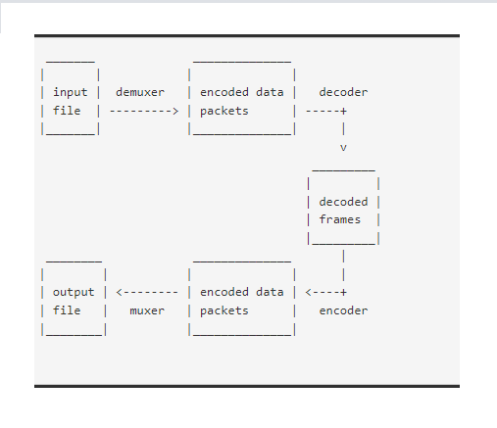
TRANSCODING FLOW & BLOCK DIAGRAM
1
User Inputs
AV codec, Bitrates, AV
& encoding options
Generate Transcoding command with provided inputs
FFmpeg decoding & Transcoding
Transcoded O/P Stream
6

Slide 10
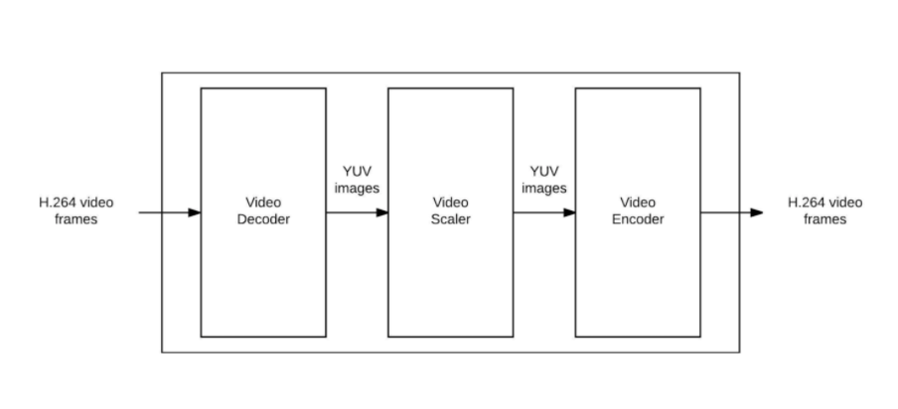
SCALING FLOW & BLOCK DIAGRAM
2
User Inputs
Resolutions, AV & encoding options
CRF or
2-Pass encoding
CRF scaling command with quality factor
2-pass encoding with desired AV bitrates & size
FFmpeg decoding, scaling & encoding
Scaled O/P stream
6

Slide 11
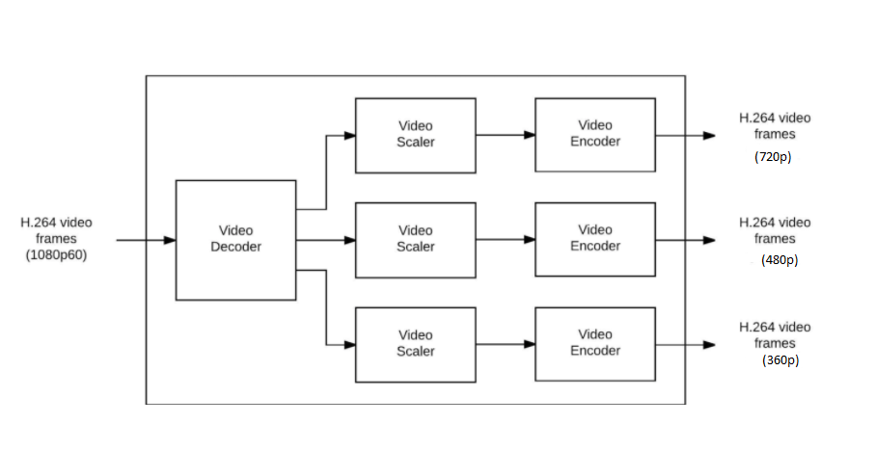
ABR STREAM GENERATION FLOW & BLOCK (FILTERING & ENCODING)
3
User Inputs
Resolutions, AV codecs, bitrates & options
Complex stream filtering
V1
V2
V3
Vn
Scaling
Vout1
Scaling
Vout2
Scaling
Vout3
Scaling
Voutn
FFmpeg HLS packager
(stream_0,stream_1...stream_n)
ABR O/P stream
(Master.m3u8)
6

Slide 12
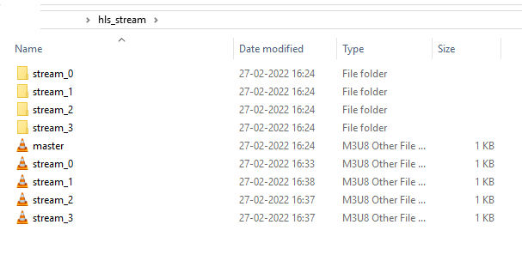
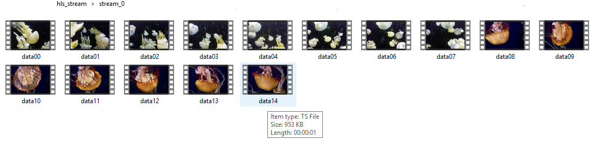
HLS PACKAGING (.ts files, stream_.m3u8, master.m3u8)

Slide 13
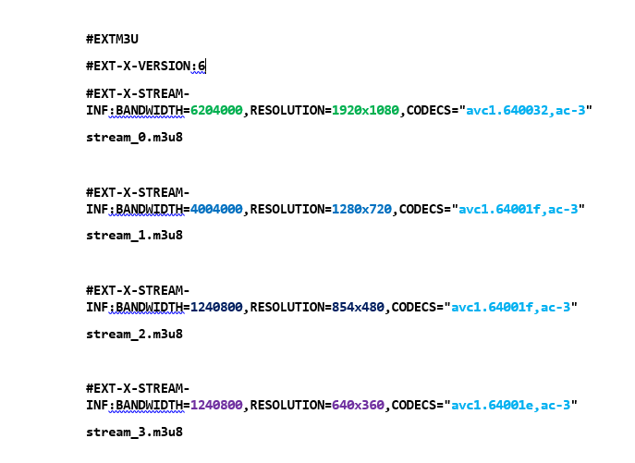
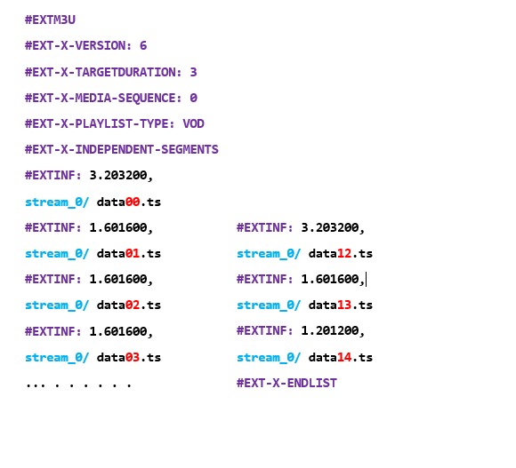
master.m3u8 Structure
Stream_.m3u8 Structure

Slide 14
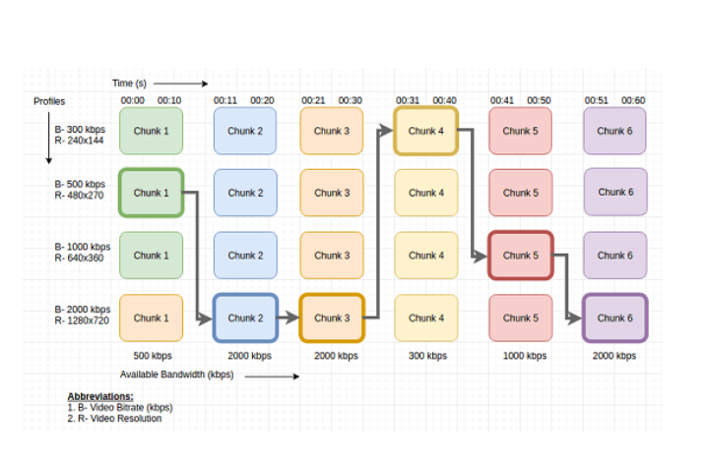
ADAPTIVE BITRATE STREAMING (ABR)

Slide 15
AV MUX / DEMUX and Processing
4
User Input
streams
5
User Input
stream
DEMUX/ MUX
Addition
Subtitle Handling
Extraction
DEMUX
MUX
Remove Video or Audio
Input Additional Video or Audio
User input .srt file
Subtitle extraction command
FFmpeg demuxing
FFmpeg muxing
FFmpeg encoding with srt
O/P .srt file
O/P Video or Audio
6
O/P AV
O/P with subtitles
6

Slide 16
Testing Generated Stream
6
Do you want to play
Play stream using FFplay
Tool Exit

Slide 17
Conclusion
FFmpeg is a open-source project which can be integrated with different coding language or scripts
Here, we are implementing a Python Tool integrated with FFmpeg to effectively perform AV compression, transcoding and processing etc
This tool provides support for playing the generated stream also using FFplay.
So, user can quickly test the video and ensure the processing is done properly or not.
We can work with the tool offline, so this tool will be helpful for the users for processing confidential or licensed video stream, which are not supposed to be uploaded and modified using online tools

Slide 18
References
https://ieeexplore.ieee.org/abstract/document/6754288
https://ieeexplore.ieee.org/abstract/document/9510129
https://ieeexplore.ieee.org/document/6976274
https://ieeexplore.ieee.org/document/7945976
https://ieeexplore.ieee.org/document/7339136
https://ieeexplore.ieee.org/document/7377577
https://ieeexplore.ieee.org/abstract/document/6912152
https://ieeexplore.ieee.org/document/5600199

Slide 19
THANK YOU

